Slide 1

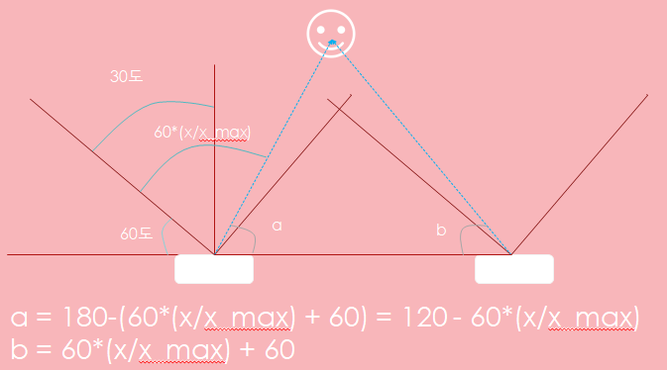







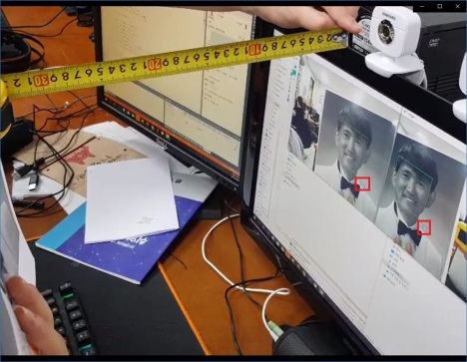





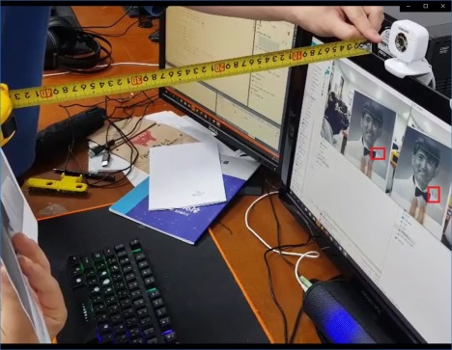


프로그램시작
face dnn model, landmark file load
Face detect(dlib)
거리 산출
프로그램 종료
distance
a
b
x
y
E1) Length(카메라 간의 간격) = x + y
E2) tan(a) = distance / x -> x = distance / tan(a)
tan(b) = distance / y -> y = distance / tan(b)
Length = x + y = distance*(cotan(a) + cotan(b))
Distance = Length / (cotan(a) + cotan(b))

